Slide 1



Lok Sabha Elections Analysis
CodeBasics Resume Project Challenge 11
Presented by
A.O.Charitha

Slide 2
List of Contents
4
1
Problem
Primary
Statement
Questions
2
5
Dataset
Secondary
Overview
Questions
6
3
Data
Recommendations
Cleaning

Slide 3
Problem Statement
AtliQ Media is a private media company and they wanted to telecast a show on Lok Sabha elections 2024 in India.
Unlike other channels they do not wish to have a debate on who is going to win this election, they rather want to present insights from the 2014 and 2019 elections without any bias and discuss less explored themes like voter turnout percentage in India.
Peter is a data analyst in the company, and he is handed over the task of generating meaningful insights from data.
You can imagine yourself as Peter and generate the insights.

Slide 4
Dataset Overview
Dimension Table: dim_state_codes.
Table contains the State name, Abbreviation, and Extracted literacy rate
from an external resource.
Fact Table 1: constituency_wise_results_2014 Dataset
Fact Table 2: constituency_wise_results_2019 Dataset
Both the Fact Tables contain the data: state,pc_name, candidate, gender,
age, category, party, party symbol, general_votes, postal_votes, total_votes,
total_electors.

Slide 5
Data Cleaning
I have analysed the 2014 and 2019 Loksabha Elections Dataset which were taken from the Election Commission of India.
In the constituency_wise_results_2014 Dataset, there are 33 Unique States.
In the constituency_wise_results_2019 Dataset, there are 36 Unique States.
The missing states in the 2014 dataset are Telangana, Chhattisgarh, and Odisha.
In 2014, Andhra Pradesh underwent bifurcation. For simplicity, all constituencies from that year should be attributed to Telangana state.
Data Cleaning included: Trimming extra Spaces, Converting case to lower, Replacing Spelling Mistakes, and Trimming extra hyphens and categories that were added in pc_name.
As per Article 84 of the constitution, individuals are eligible to become members of Parliament(MP) if; They are citizens of India and Fall under the age limit of 25 years in the case of Lok Sabha. However, There was one Applicant whose age was 24 years in the 2019 Dataset.

Slide 6
Primary Questions

Slide 7
Q1. List the top 5/ bottom 5 constituencies of 2014 and 2019 in terms of
voter turnout ratio
Top 5 Constituencies 2014
Bottom 5 Constituencies 2014
State | pc_name | Turnout Ratio
Assam | Dhubri | 88.35
Nagaland | Nagaland | 87.82
West Bengal | Tamluk | 87.59
West Bengal | Bishnupur | 86.72
West Bengal | Kanthi | 86.61
State | pc_name | Turnout Ratio
Jammu & Kashmir | Srinagar | 25.86
Jammu & Kashmir | Anantnagar | 28.84
Jammu & Kashmir | Baramulla | 39.13
Maharashtra | Kalyan | 42.88
Bihar | Patna Sahib | 45.33

Slide 8
Top 5 Constituencies 2019
Bottom 5 Constituencies 2019
State | pc_name | Turnout Ratio
Assam | Dhubri | 90.66
West Bengal | Bishnupur | 87.31
Assam | Barpeta | 86.55
West Bengal | Jalpaiguri | 86.49
Arunachal Pradesh | Arunachal east | 86.46
State | pc_name | Turnout Ratio
Jammu & Kashmir | Anantnagar | 8.94
Jammu & Kashmir | Srinagar | 14.43
Jammu & Kashmir | Baramulla | 34.57
Telangana | Hyderabad | 44.84
Maharashtra | Kalyan | 45.29

Slide 9
Q2. List the Top 5/ bottom 5 states of 2014 and 2019 in terms of
voter turnout ratio
Top 5 States 2014
Bottom 5 States 2014
State | Turnout Ratio
Nagaland | 87.82
Lakshadweep | 86.61
Tripura | 84.72
Dadra & Nagar Haveli | 84.07
Sikkim | 83.33
State | Turnout Ratio
Jammu & Kashmir | 49.65
Bihar | 56.24
Uttar Pradesh | 58.41
Maharashtra | 60.29
Madhya Pradesh | 61.59

Slide 10
Top 5 States 2019
Bottom 5 States 2019
State | Turnout Ratio
Lakshadweep | 85.17
Nagaland | 82.91
Manipur | 82.53
Tripura | 82.34
West Bengal | 81.72
State | Turnout Ratio
Jammu & Kashmir | 44.84
Bihar | 57.29
Uttar Pradesh | 59.17
NCT Of Delhi | 60.57
Maharashtra | 60.95

Slide 11
Q3. Which constituencies have elected the same party for 2 consecutive
elections, rank them by % of votes to that winning party in 2019
Top 5 Constituencies
Pc_name | Party | Vote %
Surat | BJP | 74.47
Navsari | BJP | 74.36
Vadodara | BJP | 72.29
Kangra | BJP | 72.01
Bhilwara | BJP | 71.58
There are 336 Constituencies that elected the same party for 2 consecutive elections.

Slide 12
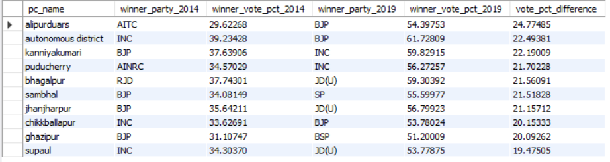
Q4. Which constituencies have voted for different parties in two elections? List the top 10 based on the difference(2019-2014) in winner vote percentage in two elections).

Slide 13
Q5. Top 5 candidates based on margin difference with runners in
2014 and 2019
Top 5 Candidates for 2014 dataset
Top 5 Candidates for 2019 dataset
Candidate | pc_name | Margin
Narendra Modi | Vadodara | 570128
Vijay Kumar SIngh | Ghaziabad | 567260
C.R.Patil | Navsari | 558116
Ramchandra Bohora | Jaipur | 539345
Darshana Vikram Jardosh | Surat | 533190
Candidate | pc_name | Margin
C.R.Patil | Navsari | 689668
Sanjay Bhatia | Karnal | 656142
Krishna pal | Faridabad | 638239
Subhash Chandra Baheria | Bhilwara | 612000
Ranjanben Bhatt | Vadodara | 589177

Slide 14
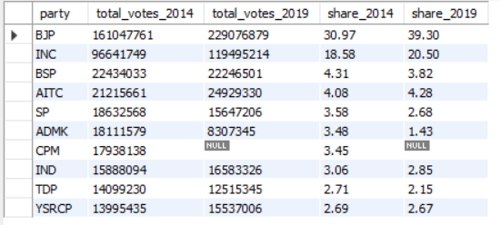
Q6. % split of votes of parties between 2014 vs 2019 at the national level

Slide 15
Q7. % split of votes of parties between 2014 vs 2019 at the state level
Top 5 Parties 2014
Top 5 Parties 2019
State | Party | Vote %
Nagaland | NPF | 68.67
Tripura | CPM | 64.01
Gujarat | BJP | 59.05
Uttarakhand | BJP | 55.32
Rajasthan | BJP | 54.94
State | Party | Vote %
Himachal Pradesh | BJP | 69.11
Gujarat | BJP | 62.21
Uttarakhand | BJP | 61.01
Rajasthan | BJP | 58.47
Arunachal Pradesh | BJP | 58.22

Slide 16
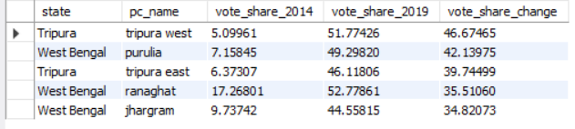
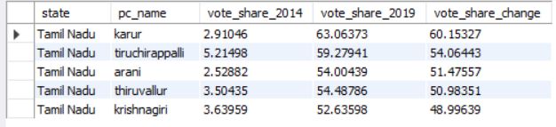
Q8. List the top 5 constituencies for two major national parties where they have gained vote share in 2019 compared to 2014.
Top 5 Constituencies for BJP where vote share is gained
Top 5 Constituencies for INC where vote share is gained

Slide 17
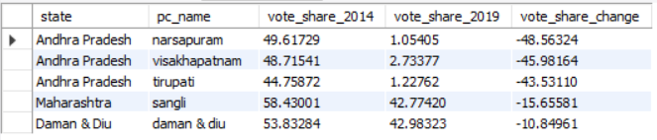
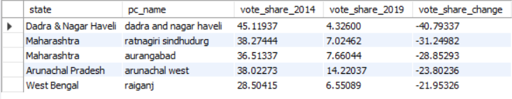
Q9. List the top 5 constituencies for two major national parties where they have lost vote share in 2019 as compared to 2014
Top 5 Constituencies for BJP where vote share is lost
Top 5 Constituencies for INC where vote share is lost

Slide 18
Q10. Which constituency has voted the most for nota?
Top Constituency in 2014
State | pc_name | Nota Vote %
Tamilnadu | Nilgiris | 4.99
Top Constituency in 2019
State | pc_name | Nota Vote %
Bihar | Gopalganj | 5.04

Slide 19
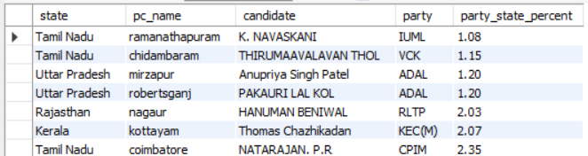
Q11. Which constituencies have elected candidates whose party has less than 10% vote share at the state level in 2019?
There are 36 Constituencies where the elected candidate’s party has less than
10% vote share at the state level in 2019 elections.

Slide 20
Secondary Questions
(Extracted Literacy Data from an external resource)

Slide 21
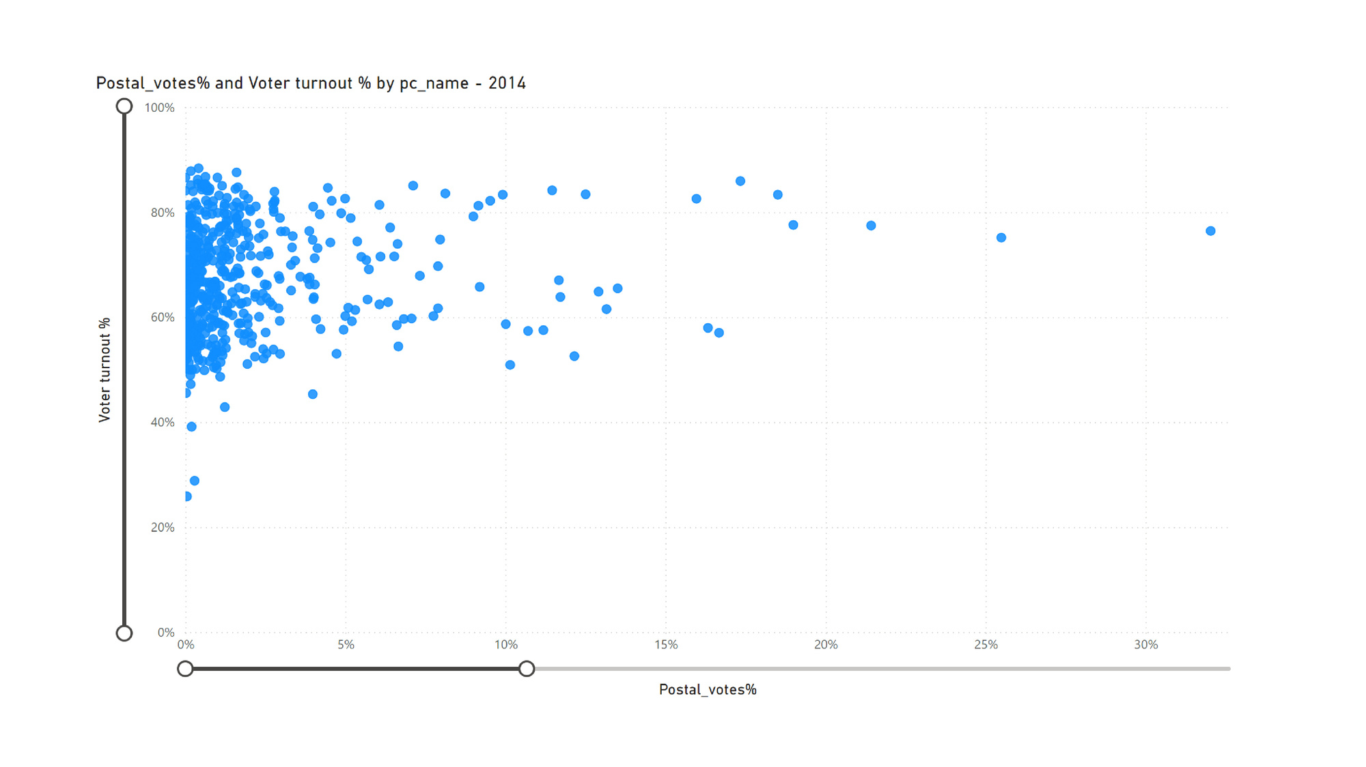
Q1. Is there a correlation between postal votes % and voter turnout %?

Slide 22
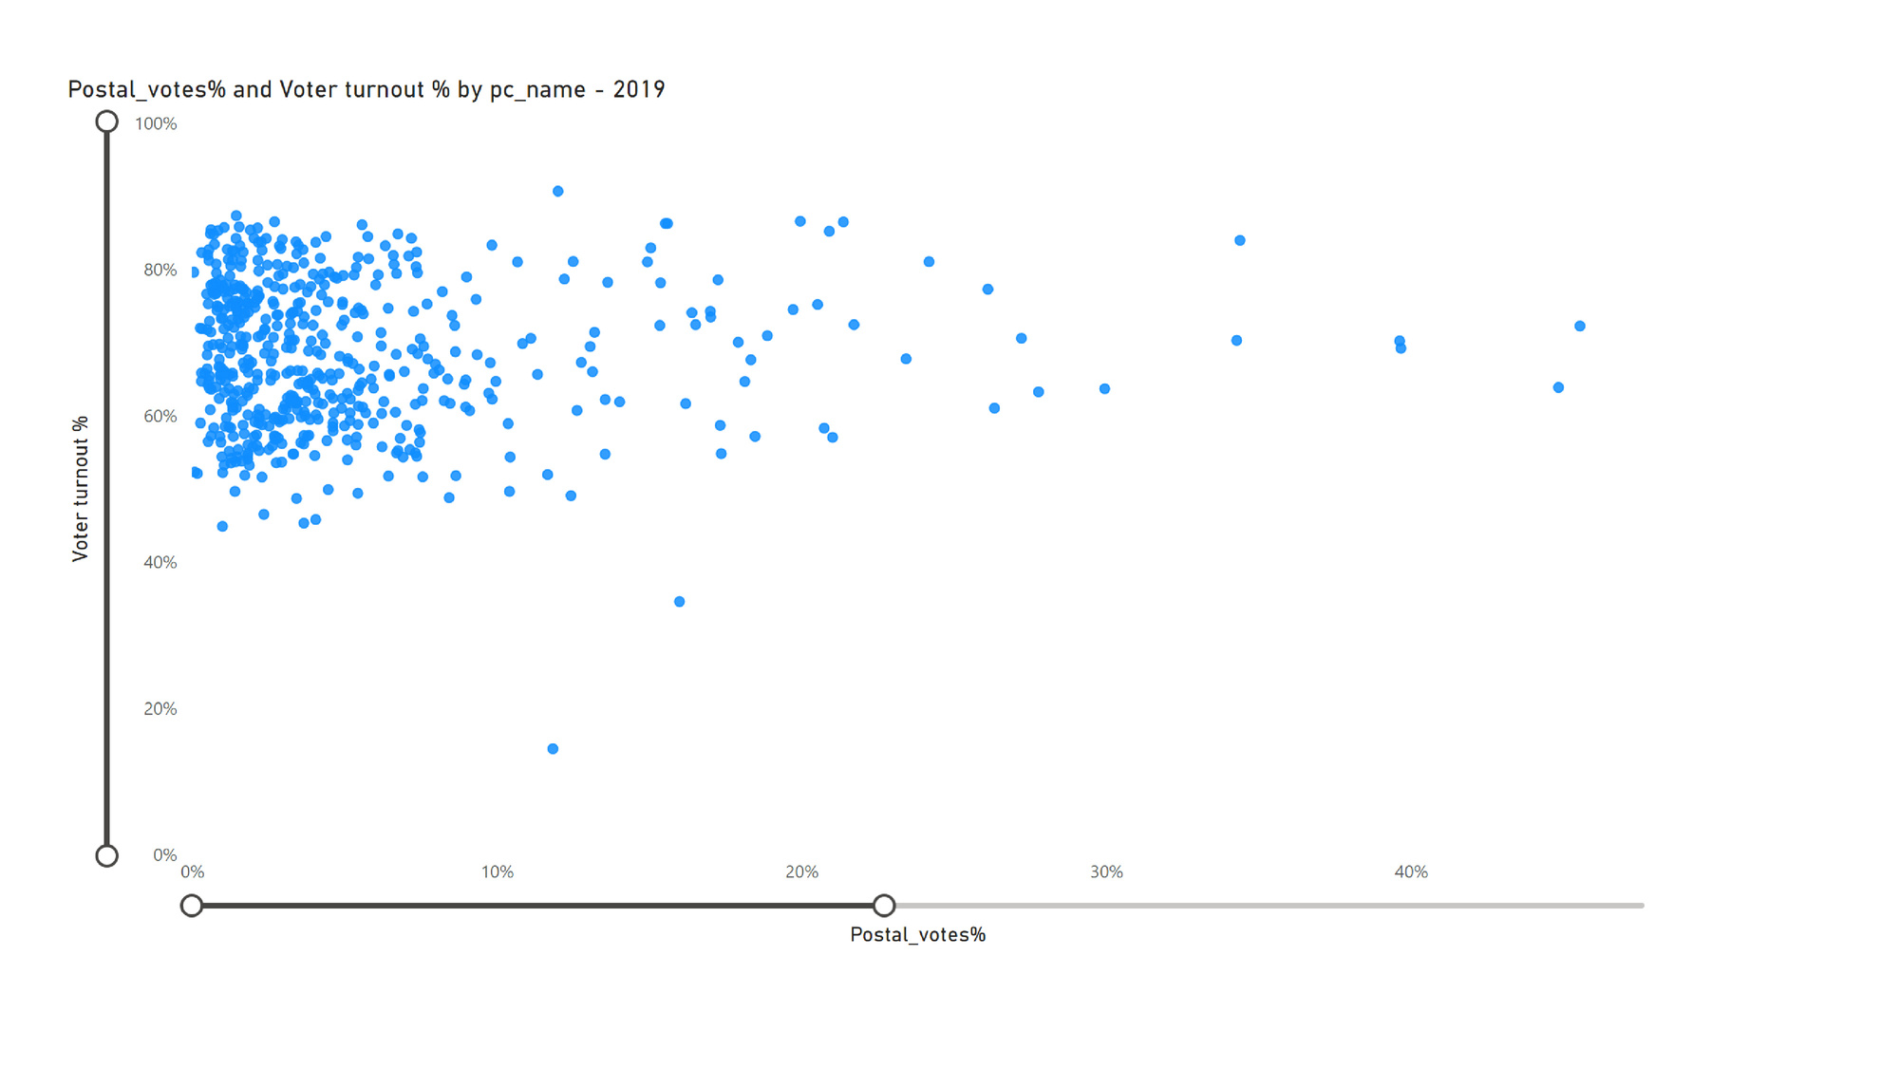
There is no Correlation since the scatter plot does not produce a lower-left-to-upper-right pattern(the lowest point of the x-axis to the highest point of the y-axis).

Slide 23
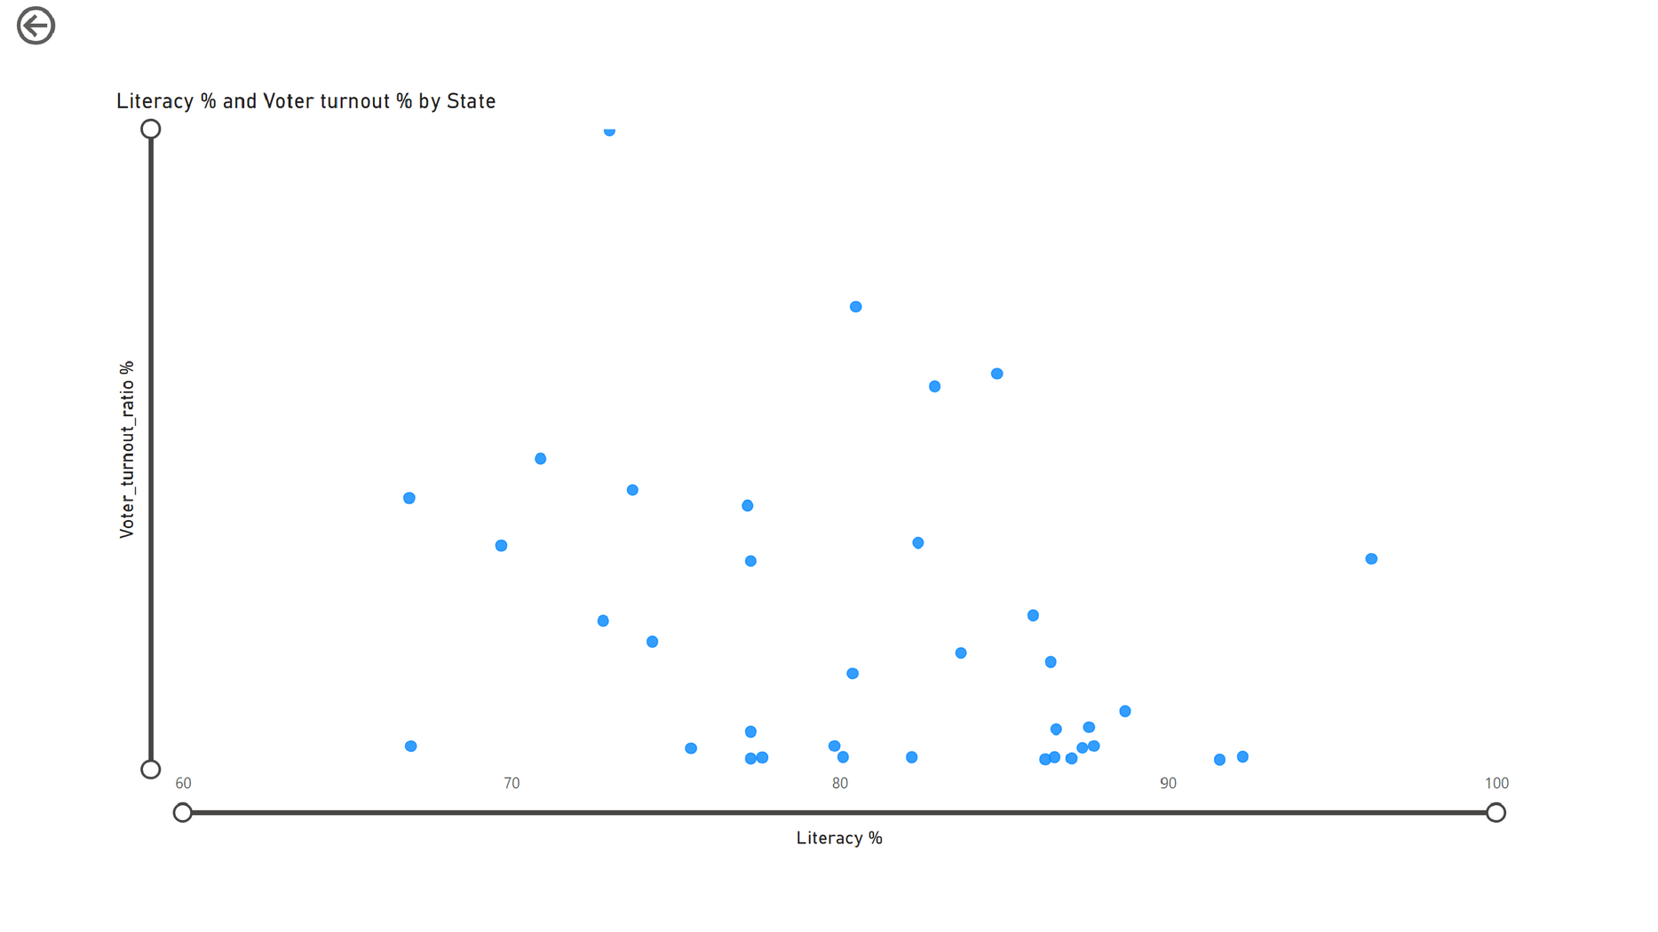
Q2. Is there a correlation between the Literacy rate of a state and
voter turnout %?
There is a Weak Correlation since the scatter plot produce
a lower-left-to-upper-right pattern.

Slide 24
Recommendations
1. Increase Voter Awareness and Participation
Low Turnout Areas: Focus on constituencies with consistently low voter turnout to understand the reasons and implement targeted voter awareness campaigns.
Postal Voting: Encourage postal voting in regions where it has shown significant uptake, potentially simplifying the process or providing more information about its availability and benefits.
2. Engage Youth and First-Time Voters
Youth Engagement: Develop programs and initiatives to engage young voters and first-time voters. Use social media and digital platforms to reach and educate them about the importance of voting.
Educational Campaigns: Conduct educational campaigns in schools, colleges, and universities to foster a culture of voting and civic participation among the youth.

Slide 25
3. Improve Electoral Process and Experience
Electoral Process Improvements: Based on feedback and data, consider improving the voting process, such as reducing waiting times, increasing the number of polling stations, or enhancing accessibility for disabled and elderly voters.
Voter Experience: Enhance voter experience by providing better information about candidates and their policies, ensuring transparency and fairness in the electoral process.
4. Address Regions with High NOTA Votes
Constituencies with High NOTA Votes: Investigate the reasons behind high NOTA votes in certain constituencies. This might indicate voter dissatisfaction with the available candidates or parties. Conduct surveys or focus groups to understand the underlying issues and address them.

Slide 26
THANK YOU
A.O.Charitha
www.linkedin.com/in/ao-charitha1

